Slide 1
GSTREAMER PLUGIN INTERACTIVE
Maria Joo – TSD/GT/KOR

Slide 2
Contents
Intel watermark plugin
Gstreamer plugin interactive

Slide 3
Intel Watermark Plugin

Slide 4
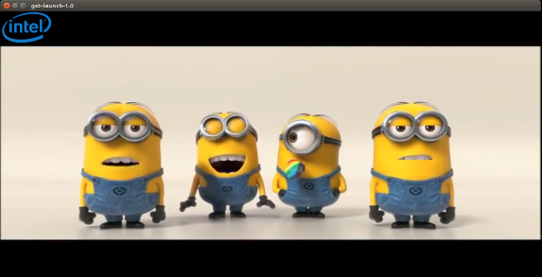

Introduction
Name : watermark_m
Class : Filter/Effect/Video
Description : Overlay an image onto a video stream
video/x-raw
video/x-raw
watermark_m
Sink
Pad
Src
Pad

Slide 5

Function Details
Offset_y
alpha
Offset_x
Overlay_
height & width

Slide 6
Gstreamer Plugin Interactive

Slide 7
Basic Concept (2)
4. Buffer
- Objects for passing streaming data between elements in pipeline
5. Messages
- Objects posted by elements on pipeline message bus
ex)) error, tag, state change, buffering state, redirect
6. Bus
- Simple system that takes care of forwarding messages from the streaming threads to an application

Slide 8
Basic Concept (3)
Application
Query
Bus
Pipeline
Message
Source
Demuxer
Decoder
Output
src
sink
src
sink
src
sink
Buffer
Event
Pad

Slide 9
Gstreamer States
4
PLAYING
GST_STATE_PLAYING :
Exactly same as PAUSED
Sink elements actually render incoming data(render video pictures to image sink)
Downstream
3
PAUSED
GST_STATE_PAUSED :
Ready to accept and handle data.
Sink elements only accept one single buffer of data and then block. (prerolled)
2
READY
GST_STATE_READY :
Allocate any non-stream-specific resources (files, network connection, memory…)
Upstream
1
NULL
GST_STATE_NULL :
Default state of an element. No runtime resources

Slide 10
Gstreamer State Change_Upstream
NULL
READY
PAUSED
PLAYING
NULL → READY
Check availability of resource
Elements open device
Pads are activated
READY → PAUSED
Streaming threads are started
running_time = 0
Link every elements
PAUSED → PLAYING
Select a clock
Calculate base_time using running_time
Calculate latency
Element
Sink
Pad
Src
Pad

Slide 11
Gstreamer State Change_Before NULL
Before NULL
element : defined element
Element are linked
Deactivated Pad
element : working element
Elements are unlinked
Activated Pad
Working Pad
gst-launch-1.0 filesrc location=/w.mp4 ! qtdemux ! decodebin ! videoconvert ! autovideosink
file-src
demuxer
decoder
videoconvert
videosink
Src
Sink
Src
Sink
Src
Sink
Src
Sink
set file location

Slide 12
Gstreamer State Change_Before NULL
NULL->READY
file-src
demuxer
decoder
videoconvert
videosink
Src
Sink
Src
Sink
Src
Sink
Src
temp
typefind
vaapi
xvimage
…

Slide 13


Gstreamer State Change_READY->PAUSED
READY->PAUSED
file-src
demuxer
decoder
videoconvert
videosink
Src
Sink
Src
Sink
Src
Sink
Src
temp
typefind
ex)) video/x-h264
video/capsfilter()
vaapi
open file
xvimage
…
typefind gsttypefindelement.c:182:gst_type_find_element_have_type:<typefind> found caps video/x-h264
GST_TYPEFIND gsttypefind.c:73:gst_type_find_register: registering typefind function for avtype_yuv4mpegpipe

Slide 14
GstStateChangeReturn
GST_STATE_CHANGE_FAILURE
GST_STATE_CHANGE_SUCCESS
GST_STATE_CHANGE_ASYNC : state change will complete later on.
ex)) sink elements need to receive first buffer before they can complete state change
GST_STATE_CHANGE_NO_PREROLL : state change succeeded but the element cannot produce data
ex)) live source

Slide 15
State variable
target_state : final target state
current_state : current state
next_state : next state
pending_state : required state

Slide 16
Scenario Introduction
Player(Bin)
file-src
demuxer
decoder
videoconvert
videosink
filesrc
qtdemux
decodebin
videoconverter
xvimagesink
Video Upstream (NULL->READY->PAUSED->PLAYING)
Seek during playing video
Lock<->Synchronize some elements in bin
Live source video

Slide 17
Gstreamer Core Library
GstElement : Abstract base class for all pipeline elements
gst_element_set_state() : set element state
gst_element_get_state() : get element state
gst_element_get_bus() : get bus of element
GstBin : Base class and element that can contain other elements
gst_bin_add () : add elements into bin
GstBus : Asynchronous message bus subsystem
gst_bus_timed_pop_filtered() : get a message from the bus
GstClock : Abstract class for global clocks
GstMessage : Objects to signal the application of pipeline events
GstStateChangeReturn

Slide 18
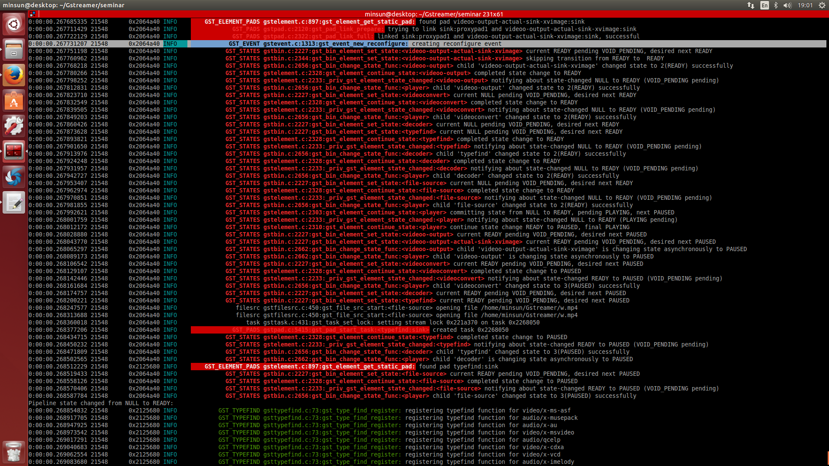
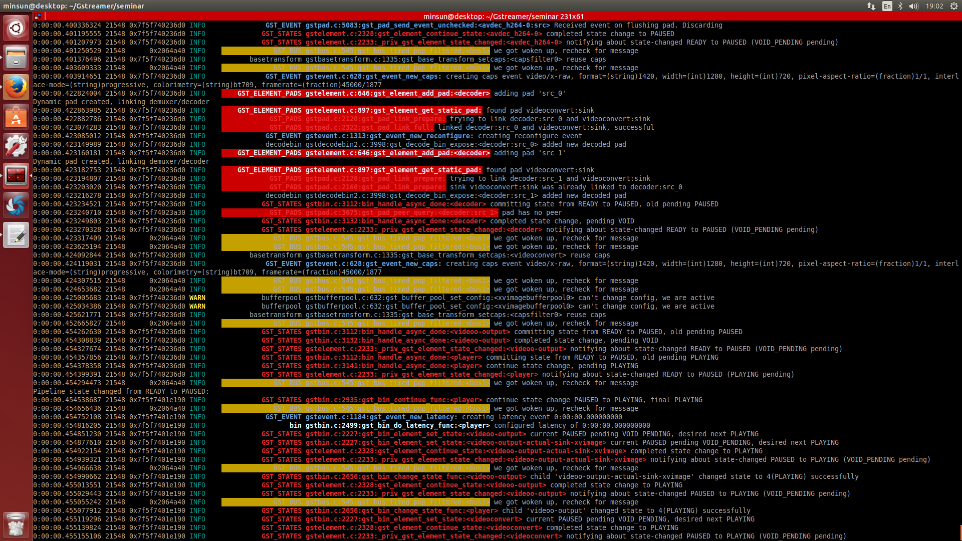
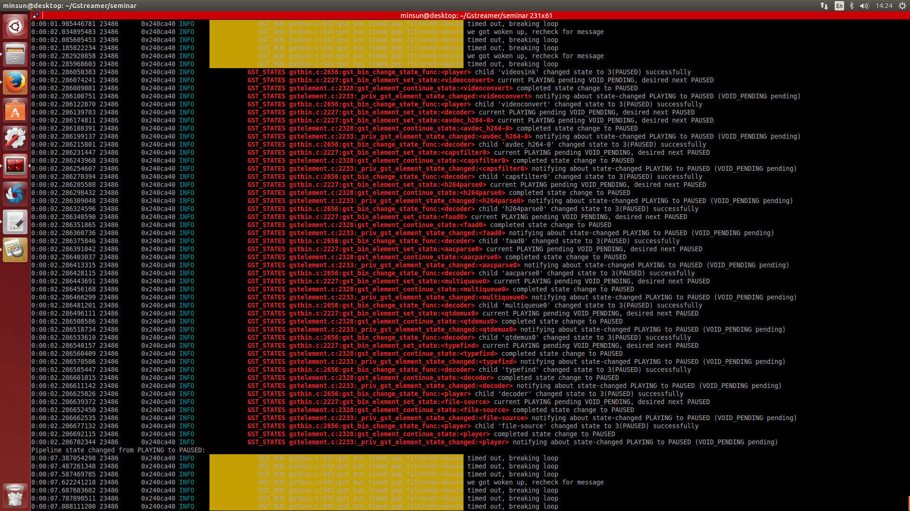
Scenario 1_Upstream video (NULL->PLAYING)
Element
Bus
set_state(PLAYING)
set_state(PLAYING)
change_state(NULL, READY)
continue_state(SUCCESS|FAILED)
if SUCCESS
STATE_CHANGED(NULL, READY, PLAYING)
STATE_CHANGED(READY, PAUSED, PLAYING)
if SUCCESS
change_state(PAUSED, PLAYING)
continue_state(SUCCESS|FAILED)
STATE_CHANGED(PAUSED, PLAYING, VOID)
return SUCCESS

Slide 19
GstBin-Manages Child States
bin
c1
c2
set_state(bin, N)
change_state()
if state(c1)<=N set_state(c1, N)
change_state(P, N)
STATE_CHANGED
SUCCESS | FAILSED
if SUCCESS
if state(c2)<=N set_state(c2, N)
change_state(P, N)
STATE_CHANGED
SUCCESS | FAILSED

Slide 20

Asynchronous State Changes_Single Element (1)
Element
Sink
Buffer
ASYNC
change_state() returns ASYNC
ASYNC_START / ASYNC_DONE messages
When done, post ASYNC_DONE and
gst_element_abort_state() & ERROR message on failure or
gst_element_continue_state()*, or
GstBin subclass: GstBin handle_message() instead of posting directly

Slide 21
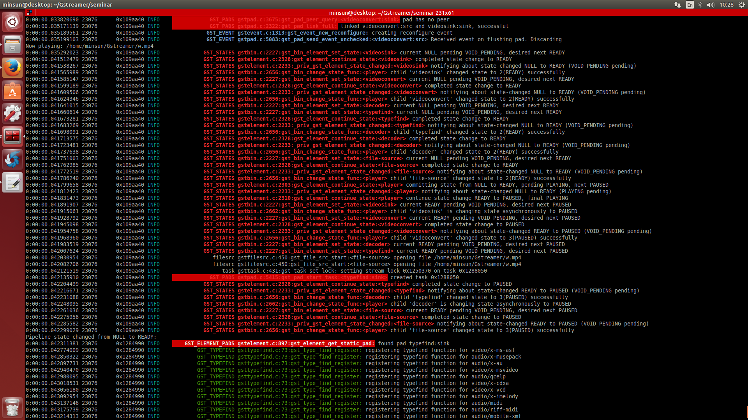
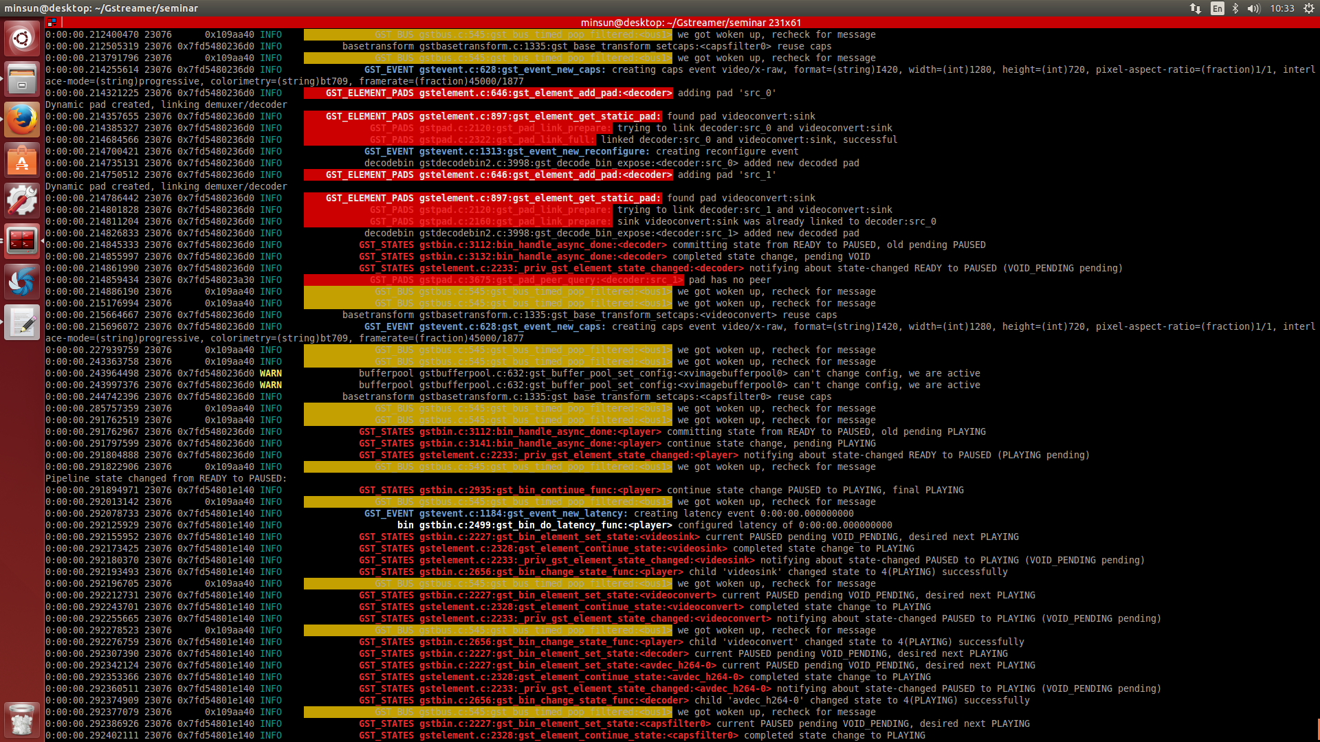
Asynchronous State Changes_Single Element (2)
Element
Bus
set_state(S)
change_state(P, S)
ASYNC_START
return ASYNC
ponder & set next, pending, current, state_ret
ASYNC_DONE
continue_state(SUCCESS)
STATE_CHANGED(…)

Slide 22
Asynchronous State Changes_GstBin (1)
bin
child
set_state(S)
ASYNC_START
return ASYNC
if first async element ASYNC_START
return ASYNC
ASYNC_DONE
if last async element
gst_bin_continue_func()
change_state()

Slide 23
Asynchronous State Changes_GstBin (2)
Adding / removing elements checks for ASYNC
Can trigger new async state changes
Async-handling property=true || top-level bin
Only these are doing the continue part

Slide 24
Scenario 2_Seek_video (Losing State)
Flushes move sinks out of PLAYING/PAUSED
gst_element_lost_state()
Posts ASYNC_START, pending=PAUSED, target=old state, current= PAUSED, next=PAUSED
Does not go through change_state()
Handled in bins exactly the same

Slide 25
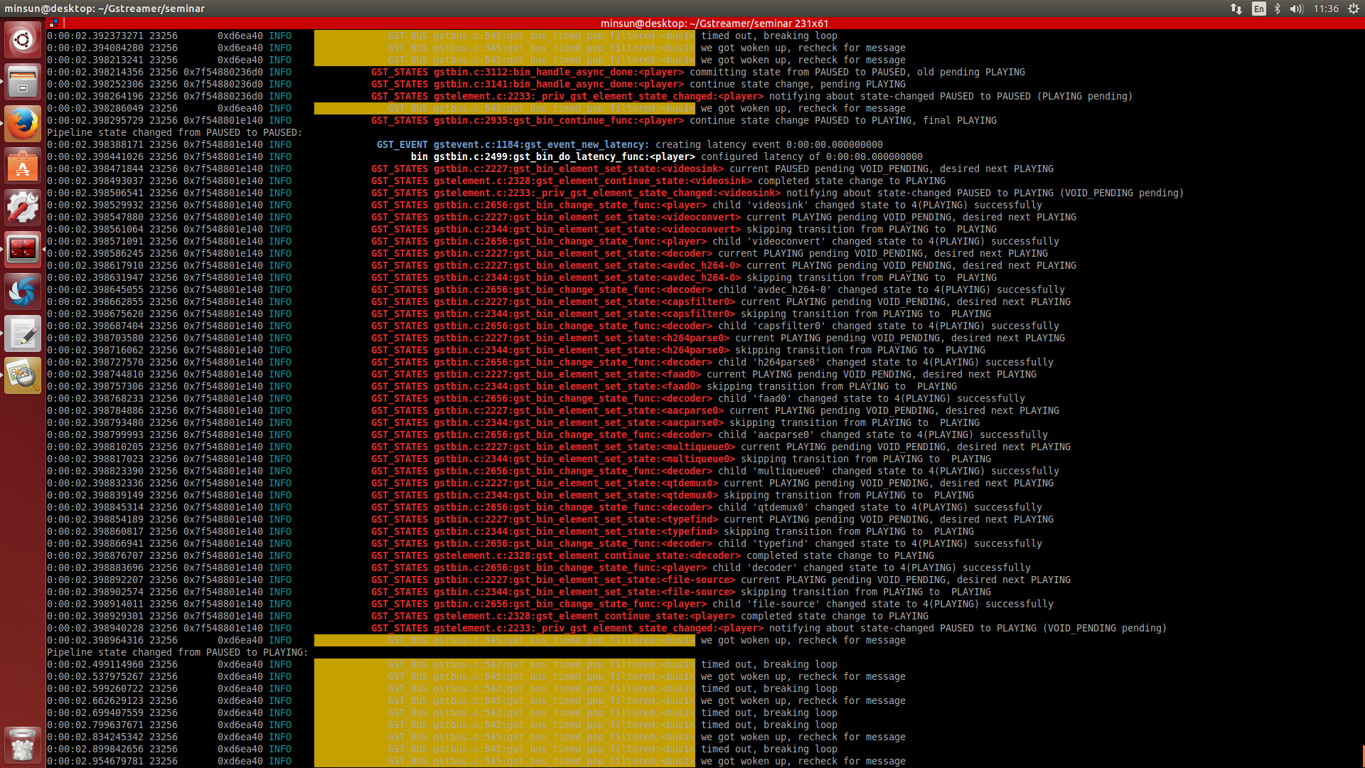
Scenario 2_Seek_video (Losing State)
bin
child
lost_state()
ASYNC_START
if first async element ASYNC_START
ASYNC_DONE
if last async element
gst_bin_continue_func()
change_state(PAUSED)
change_state(target)

Slide 26
Scenario 3_Lock<->Synchronization
Keep elements’ state along with bin
gst_element_sync_state_with_parent()
Make some element independent from bin
gst_element_set_locked_state()

Slide 27
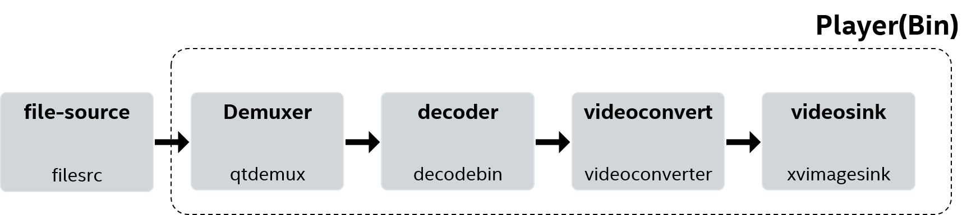

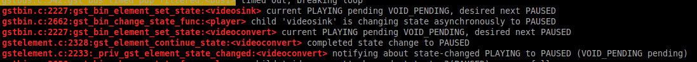
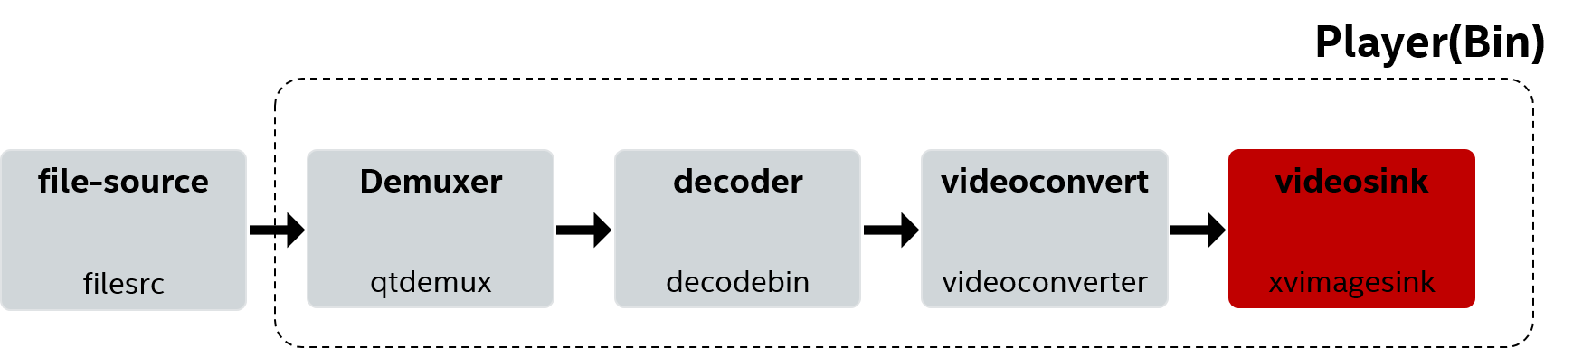
Scenario 3_Lock/Sync states in GstBin
Before Lock(Sync)
After Lock(Unsync)

Slide 28
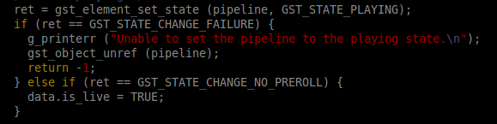
Scenario 4_Live Source (No_Preroll)
Returns SUCCESS or ASYNC
NO_PREROLL
Don’t stay in PAUSED for long
PAUSED is reached immediately without waiting for preroll

